Slide 1

Data Analytics & Architecture
Semantic Layer Strategy and Maturity
August 2022

Slide 2
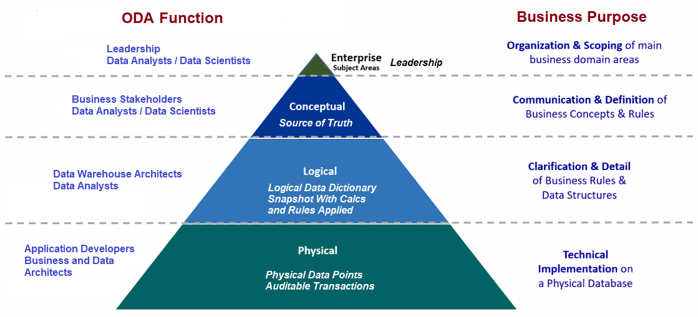
Modern Data Analytics and Semantic Layers
A semantic layer translates technical metadata into friendlier business metadata.
Notes:
Levels 4-1 is what I call these. Level 1 being executive level.
Level 4 is the raw data level.
Level 3 is the data curation level and is critical to self-service reporting
Level 2 is the data modeling level and is critical to predictive and trending operational perspectives.
Level 1 is the visionary level and it brings leadership perspectives and changes into the view of possibilities.

Slide 3
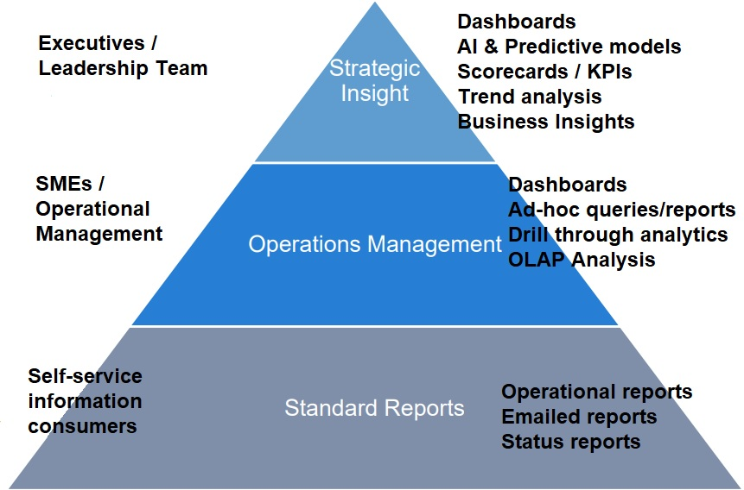
Who are the BI Consumers at each semantic level?
Level 1
Data Asset Value and ROI
Level 2
Level 3
Notes:
Level 3 Data curation provides the methodological and technological data management support to address data quality issues maximizing the usability of the data.
The core impact of data curation is to enable more complete and high-quality data-driven models for knowledge organizations with self-service reporting.
Crowdsourcing : Data curation can be a resource-intensive and complex task, which can easily exceed the capacity of a single individual.
Level 2 Data modelling and Common Data Modelling (CDM) enable the simultaneous analysis of disparate data sources.
The analytical models from data mining and computer science heuristics help in analysis and visualization of data, predicting student performance, generating recommendations for students as well as teachers, providing feedback to students, identifying related courses, e-content and books, detecting undesirable student behaviors and developing course content.
Level 1 Predictive Data Modelling. Uses high-dimensional semantic vectors derived from large-scale datasets like social media or Google or web scraping and applies machine learning techniques to map these vectors onto leadership change effectiveness.

Slide 4


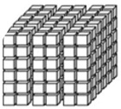

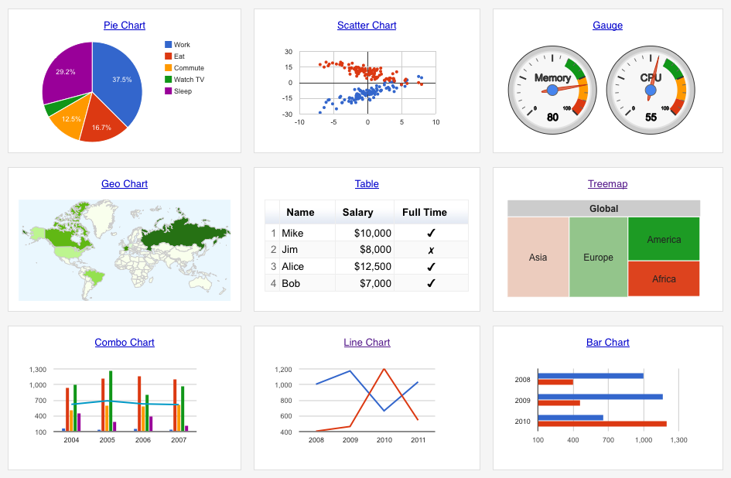


Level 3 semantic layer - Headless BI
DAX
SQL
MDX
Python
Notes:
▶ A Business Analytics platform – BI tool agnostic
BI tools are continuously evolving, so it’s important to take a long-term investment view and avoid vendor lock-in of the semantic layer.

Slide 5
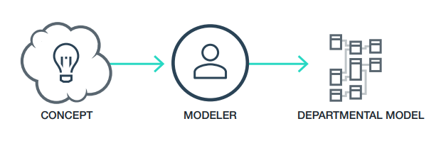
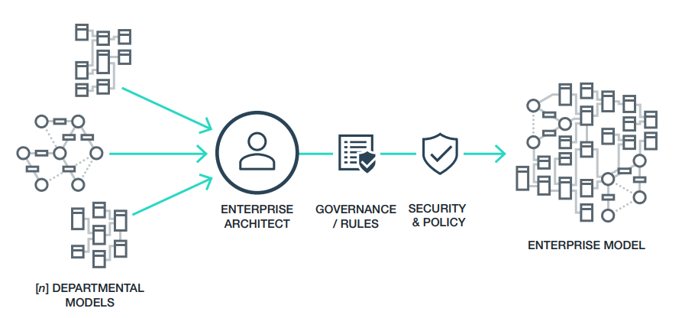
Level 2 data modelling - “model of models”
▶ The Enterprise Entity – the entities to model must be crafted from a collection of other previously modeled entities as opposed to “modeling them from scratch.”
Notes:
The ability to make inferences about data and complex relationships via rule sets.
For example, we might create rules such that when two facts are true (or two relationships exist), we may infer that a third fact or relationship exists without it being explicitly encoded in the data.

Slide 6
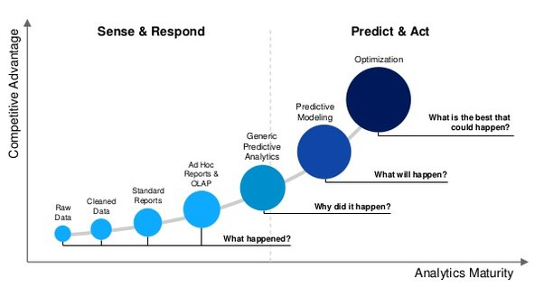
Level 1 strategic modelling.
▶ Predictive models and Explanatory Models and Computational models.
Notes:
When building multivariate statistical models, researchers need to be clear as to whether their goals are explanatory or predictive.
Explanatory research aims to identify risk (or protective) factors that are causally related to an outcome.
Predictive research aims to find the combination of factors that best predicts a current diagnosis or future event.
This distinction affects every aspect of model building and evaluation.

Slide 7
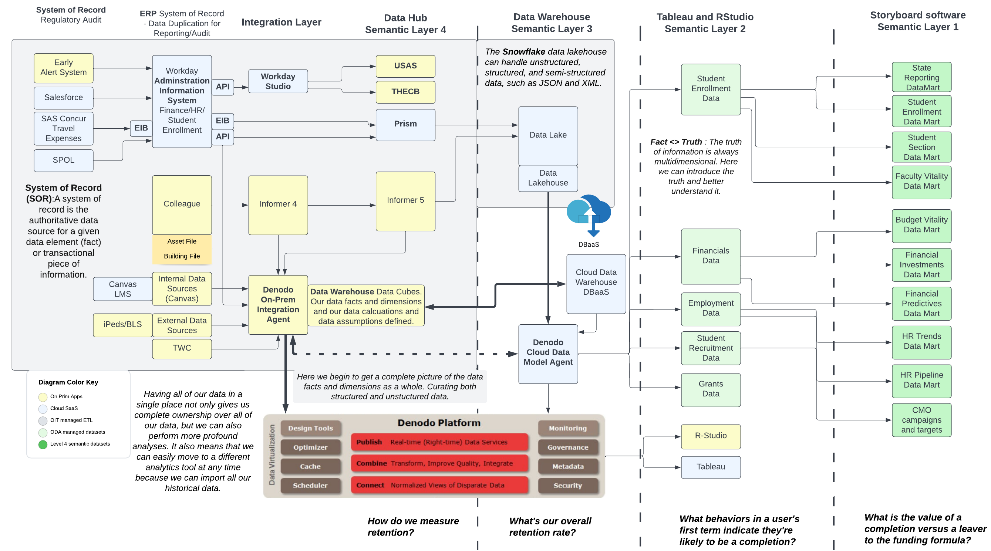
How does our architecture support our Semantic Layers?
Notes:
One of the key principles of data analytics is that the quality of the analysis is dependent on the quality of the information analyzed.
Gartner estimates that more than 25% of critical data in the world’s top companies is flawed (Gartner 2007).

